Slide 1
Project 1 – My Shell
Let’s get started…

Slide 2
1.1 Compile and Validate
A task is a unit of execution (also referred to as a process).
A shell (Command Language Interpreter) is a task that functions as an interface between the user and an Operating System.
A shell interprets textual commands coming either from the user’s keyboard or from a script file and executes the commands either directly or creates a new child process to execute the command.
For Project 1:
Download all the project files from class website.
os345.c, os345interrupts.c, os345signals.c os345tasks.c, os345semaphores.c
os345.h, os345config.h, os345signals.h
os345p1.c, os345p2.c, os345p3.c, os345p4.c, os345p5.c, os345p6.c
os345park.c, os345park.h, os345lc3.c, os345lc3.h, os345mmu.c, os345fat.c, os345fat.h
Edit os345config.h (if necessary) to select host OS/IDE/ISA. (Only enable one of the following defines: DOS, GCC, MAC, or NET.)
Compile and execute your OS.

Slide 3
1.2 Malloc/free argc/argv
Command-line Arguments
All tasks functions (main) are passed two arguments:
The first (conventionally called argc, for argument count) is the number of command-line arguments (including the program name).
The second (argv, for argument vector) is a pointer to an array of character pointers (strings) that contain the arguments, one per string.
By convention, argv[0] points to the program name and argv[argc] is a null pointer.
Modify the function P1_shellTask() (os345p1.c) to parse the commands and parameters from the keyboard inbuffer string into traditional argc and malloc'd argv C variables:
Your shell executes the command directly using a function pointer with malloc’d arguments, waits for the function to return, and then recovers memory (free) before prompting for the next command.
Commands and arguments are case insensitive.
Quoted strings are treated as one argument and case is preserved within the string.

Slide 4
1.3 Background Tasks
Implement background execution of programs:
If the command line ends with an ampersand (&), your shell creates a new task to execute the command line. (Otherwise, your shell calls the command function (and waits for the function to return.)
Use the createTask function to create a background process.
int createTask(char* name, // task name
int (*task)(int, char**), // task address
int priority, // task priority
int argc, // task argument count
char** argv) // task argument point
The command arguments are passed to the new task in malloc'd argv strings. Modify the function createTask (os345tasks.c) to malloc new argc and argv variables.
Modify the function sysKillTask (also in os345tasks.c) to recover malloc'd createTask memory.

Slide 5
1.4 Signals
A signal is an asynchronous notification of an event that is sent to a process before it is rescheduled for execution.
Blocked processes are not un-blocked by a signal, but rather the signal remains pending until such time as the process is un-blocked and scheduled for execution.
Before a task is scheduled by the function dispatcher (os345.c), the function signals (os345signals.c) is called:
Modify the function signals (os345signals.c) to call all pending task signal handlers.
Modify the function createTaskSigHandlers (os345signals.c) such that a child task inherits all its parent signal handlers.
Modify the function sigAction (os345signals.c) to register new task signal handlers.
Add default signal handlers as needed.
Implement all signals and signal handlers such that:
Cntrl-X terminates (kills) all tasks except task 0 (shell).
Cntrl-W pauses the execution of all tasks.
Cntrl-R continues the execution of all tasks after a pause.

Slide 6
1.5 Finishing up…
Implement the following shell commands:
Add – add all numbers in command line (decimal or hexadecimal).
Args – list all parameters on the command line, numbers or strings.
(Bonus) Add additional functionality to your Shell such as:
Command line recall of one or more previous commands.
Help implemented using the “more” filter.
Be able to edit command line (insert / delete characters).
Chain together multiple commands separated by some delimiter.
List / Set command line variables for aliasing.
Calculator – perform basic binary operations.
Date/Time – output current system date and time.
Help – list all user commands and the syntax of their arguments. Help should be selective and have at least two levels of hierarchical depth.
(Bonus) Command line recall/edit

Slide 7
File Summary…
Files needing attention:
os345tasks.c – createTask, sysKillTask
os345interrupts.c – keyboard_isr
os345signals.c – signals, sigAction, sigSignal, defaultSigxxHandler, createTaskSigHandlers
os345p1.c – P1_shellTask, P1_help …
os345.h – your equates
Event Handlers
int signals(void);
int sigAction(void (*sigHandler)(void), int sig);
int sigSignal(int taskId, int sig);
void defaultSigxxxHandler(void);
void createTaskSigHandlers(int tid)

Slide 8
Event-driven programming
Event-driven programming is a programming paradigm in which the flow of the program is determined by
sensor outputs,
user actions (mouse clicks, key presses), or
messages from other programs or threads.
interrupts
Application has a main loop
Event selection (scheduler).
Event handling (dispatcher).
Events are external to a task
Signals are asynchronous events
Occur anytime, handled by call-back functions
Semaphores are synchronous events.
Occur anytime, handled by semaphores

Slide 9
Signals
Signals
Dispatcher calls signal handlers before rescheduling task:
void mySIGINTHandler(void) void mySIGTERMHandler(void)
{ sigSignal(-1, SIGTERM); { killTask(curTask);
return; return;
} }
keyboard_isr() detects a cntrl-X and sends a SIGINT signal to the shell:
sigSignal(0, SIGINT);
Task registers call-back signal handler functions with the OS:
sigAction(mySIGINTHandler, SIGINT);
sigAction(mySIGTERMHandler, SIGTERM);
createTask()
dispatch()
killTask()
New
Ready
Running
Exit
SWAP
createTask calls createTaskSigHandlers() to setup
default / parent signal handlers:
void createTaskSigHandlers(int tid)
{ tcb[tid].sigIntHandler = defaultSigIntHandler;
tcb[tid].sigTermHandler = defaultSigTermHandler;
return;
}

Slide 10
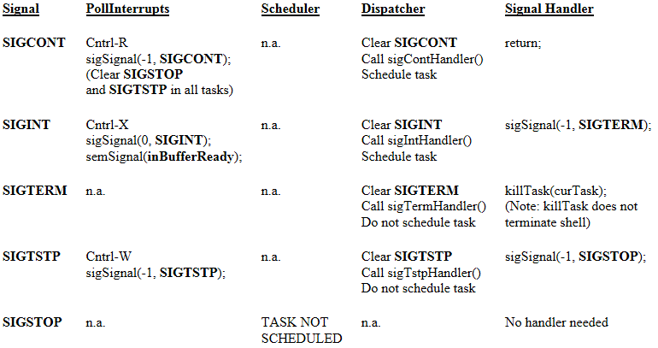
Signal Handling
Signals

Slide 11
Keyboard Interrupts
Keyboard Input | Action
Cntrl-X | sigSignal SIGINT to shell Clear input buffer semSignal inBufferReady
Cntrl-R | sigSignal SIGCONT to all tasks Clear SIGSTOP from all tasks Clear SIGTSTP from all tasks
Cntrl-W | sigSignal SIGTSTP to all tasks

Slide 12
Grading Criteria…
There are 7 points possible for Lab 1:
2 pts – Your shell parses the command line into argc and malloc'd argv argument variables. Function createTask() malloc’s and copies argv argument variables as well. All malloc'd memory is appropriately recovered by sysKillTask().
1 pt – Commands and arguments are case insensitive. Quoted strings are treated as one argument and case is preserved within the string.
Backspace is implemented (delete character to the left) and correctly handles input buffer under/overflow.
2 pts – The signals SIGCONT, SIGINT, SIGTSTP, SIGTERM, and SIGSTOP function properly as described.
1 pt – The required shell commands add and args are correctly implemented.
(The add command handles hexadecimal as well as decimal arguments.)
1 pt – Your shell supports background execution of all commands.
In addition, the following bonus/penalties apply:
+1 pt – Early pass-off (at least one day before due date.)
+1 pt – An additional shell function of your choice is implemented.
+2 pts – Implementing command line recall.
-1 pt – Each school day late.

Slide 13
Miscellaneous…
Project 1
Written in C (not C++)
Shell commands are C functions.
Arguments parsed into traditional C argc and malloc'd argv variables.
Support background execution of command programs (& at the end of the line).
Keyboard polled (pollInterrupts) during the scheduling loop.
Before a process is scheduled/dispatched, properly handle any pending signals.
SWAP macros liberally placed throughout your code.
Handle strings, quoted strings, decimal numbers, or hexadecimal numbers.
Commands may be terse and/or verbose (ie, ls and list).
Some extended form of on-line help is required.
Define argument delimiters, command delimiters, and address case sensitivity issues.
Make your shell scalable.
Notes:
13

Slide 15
Event-driven programming
Batch version
read a number (from the keyboard) and store it in variable A[0]
read a number (from the keyboard) and store it in variable A[1]
print A[0]+A[1]
Event-driven version
k = 0;
while (1)
{ if ( c = getCharacter() )
{ A[k++] = c;
if (k == 2)
{ print A[0]+A[1];
k = 0;
}
}
}

Slide 16
Command-line Arguments
Command-line Arguments
By standards, argv[argc] is a null pointer.
argv:
echo\0
Must be
malloc’d
hello\0
world\0
// echo command-line arguments
int main(int argc, char* argv[ ])
{
while (--argc > 0)
printf("%s%s", *++argv, (argc > 1) ? " " : "");
printf("\n");
return 0;
}

